Slide 1

Welcome! tap on the logo to continue…

Slide 2


MOB 12:
Bellz Beyond Christmas
Attending our concert today? Stay on Track with us here!
Program Booklet
Repertoire
* Click on the logo to return to main menu
Notes:
Higlighted red text to be included as hover text

Slide 3
Repertoire
Bunga Sayang
Carol of the Drum
Sleigh Ride
A Christmas Festival
Frosty the Snowman
Jingle Bell Rock
Wizards in Winter
Raindrops Keep Falling on my Head
Andromeda
Nocturnal Fantasy
When You Wish Upon a Star
BACK
* Click on the logo to return to main menu
Notes:
Higlighted red text to be included as hover text

Slide 4
Tick it off, one-by-one
Bunga Sayang
Carol of the Drum
Sleigh Ride
A Christmas Festival
Frosty the Snowman
Jingle Bell Rock
Wizards in Winter
Raindrops Keep Falling on my Head
Andromeda
Nocturnal Fantasy
When You Wish Upon a Star
My Neighbour Totoro
* Click on the logo to return to main menu
Notes:
Higlighted red text to be included as hover text

Slide 5
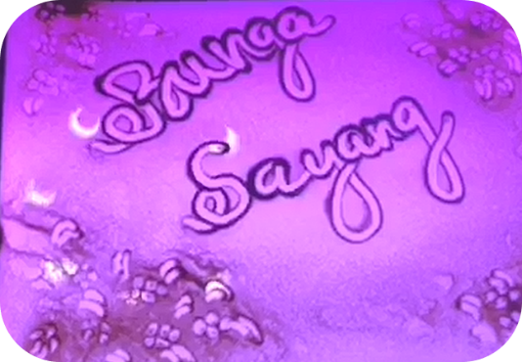

Tick it off, one-by-one
Bunga Sayang
Carol of the Drum
Sleigh Ride
A Christmas Festival
Frosty the Snowman
Jingle Bell Rock
Wizards in Winter
Raindrops Keep Falling on my Head
Andromeda
Nocturnal Fantasy
When You Wish Upon a Star
My Neighbour Totoro
Finished?
NO
* Click on the logo to return to main menu
Notes:
Higlighted red text to be included as hover text

Slide 6

Tick it off, one-by-one
Bunga Sayang
Carol of the Drum
Sleigh Ride
A Christmas Festival
Frosty the Snowman
Jingle Bell Rock
Wizards in Winter
Raindrops Keep Falling on my Head
Andromeda
Nocturnal Fantasy
When You Wish Upon a Star
My Neighbour Totoro
* Click on the logo to return to main menu
Notes:
Higlighted red text to be included as hover text

Slide 7
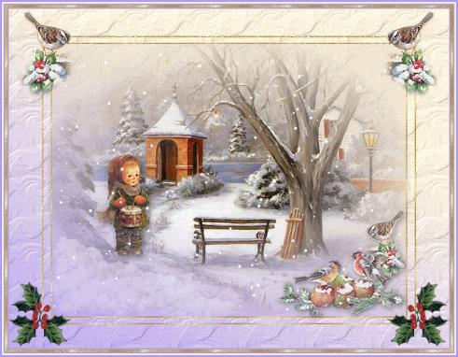
Tick it off, one-by-one
2. Carol of the Drum
Bunga Sayang
Carol of the Drum
Sleigh Ride
A Christmas Festival
Frosty the Snowman
Jingle Bell Rock
Wizards in Winter
Raindrops Keep Falling on my Head
Andromeda
Nocturnal Fantasy
When You Wish Upon a Star
My Neighbour Totoro
Finished?
NO
* Click on the logo to return to main menu
Notes:
Higlighted red text to be included as hover text

Slide 8
Tick it off, one-by-one
Bunga Sayang
Carol of the Drum
Sleigh Ride
A Christmas Festival
Frosty the Snowman
Jingle Bell Rock
Wizards in Winter
Raindrops Keep Falling on my Head
Andromeda
Nocturnal Fantasy
When You Wish Upon a Star
My Neighbour Totoro
* Click on the logo to return to main menu
Notes:
Higlighted red text to be included as hover text

Slide 9
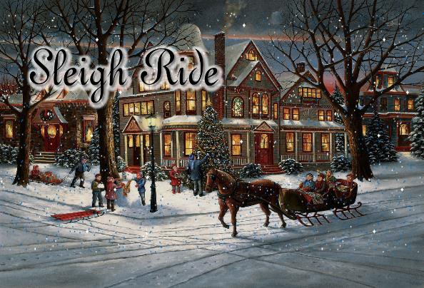
Tick it off, one-by-one
Bunga Sayang
Carol of the Drum
Sleigh Ride
A Christmas Festival
Frosty the Snowman
Jingle Bell Rock
Wizards in Winter
Raindrops Keep Falling on my Head
Andromeda
Nocturnal Fantasy
When You Wish Upon a Star
My Neighbour Totoro
Finished?
NO
* Click on the logo to return to main menu
Notes:
Higlighted red text to be included as hover text

Slide 10
Tick it off, one-by-one
Bunga Sayang
Carol of the Drum
Sleigh Ride
A Christmas Festival
Frosty the Snowman
Jingle Bell Rock
Wizards in Winter
Raindrops Keep Falling on my Head
Andromeda
Nocturnal Fantasy
When You Wish Upon a Star
My Neighbour Totoro
* Click on the logo to return to main menu
Notes:
Higlighted red text to be included as hover text

Slide 11

Tick it off, one-by-one
Bunga Sayang
Carol of the Drum
Sleigh Ride
A Christmas Festival
Frosty the Snowman
Jingle Bell Rock
Wizards in Winter
Raindrops Keep Falling on my Head
Andromeda
Nocturnal Fantasy
When You Wish Upon a Star
My Neighbour Totoro
Finished?
NO
* Click on the logo to return to main menu
Notes:
Higlighted red text to be included as hover text

Slide 12
Tick it off, one-by-one
Bunga Sayang
Carol of the Drum
Sleigh Ride
A Christmas Festival
Frosty the Snowman
Jingle Bell Rock
Wizards in Winter
Raindrops Keep Falling on my Head
Andromeda
Nocturnal Fantasy
When You Wish Upon a Star
My Neighbour Totoro
* Click on the logo to return to main menu
Notes:
Higlighted red text to be included as hover text

Slide 13
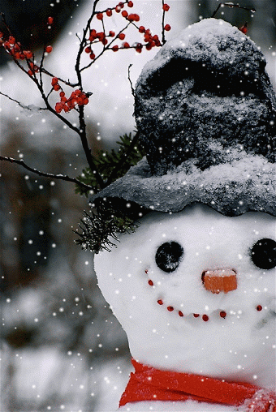
Tick it off, one-by-one
5. Frosty the Snowman
Bunga Sayang
Carol of the Drum
Sleigh Ride
A Christmas Festival
Frosty the Snowman
Jingle Bell Rock
Wizards in Winter
Raindrops Keep Falling on my Head
Andromeda
Nocturnal Fantasy
When You Wish Upon a Star
My Neighbour Totoro
Finished?
NO
* Click on the logo to return to main menu
Notes:
Higlighted red text to be included as hover text

Slide 14
Tick it off, one-by-one
Bunga Sayang
Carol of the Drum
Sleigh Ride
A Christmas Festival
Frosty the Snowman
Jingle Bell Rock
Wizards in Winter
Raindrops Keep Falling on my Head
Andromeda
Nocturnal Fantasy
When You Wish Upon a Star
My Neighbour Totoro
* Click on the logo to return to main menu
Notes:
Higlighted red text to be included as hover text

Slide 15

Tick it off, one-by-one
6. Jingle Bell Rock
Bunga Sayang
Carol of the Drum
Sleigh Ride
A Christmas Festival
Frosty the Snowman
Jingle Bell Rock
Wizards in Winter
Raindrops Keep Falling on my Head
Andromeda
Nocturnal Fantasy
When You Wish Upon a Star
My Neighbour Totoro
Finished?
NO
* Click on the logo to return to main menu
Notes:
Higlighted red text to be included as hover text

Slide 16
Tick it off, one-by-one
Bunga Sayang
Carol of the Drum
Sleigh Ride
A Christmas Festival
Frosty the Snowman
Jingle Bell Rock
Wizards in Winter
Raindrops Keep Falling on my Head
Andromeda
Nocturnal Fantasy
When You Wish Upon a Star
My Neighbour Totoro
* Click on the logo to return to main menu
Notes:
Higlighted red text to be included as hover text

Slide 17
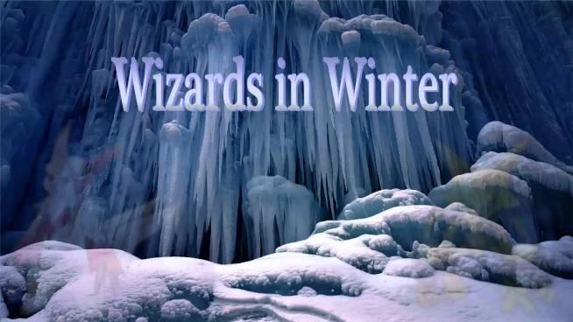
Tick it off, one-by-one
Bunga Sayang
Carol of the Drum
Sleigh Ride
A Christmas Festival
Frosty the Snowman
Jingle Bell Rock
Wizards in Winter
Raindrops Keep Falling on my Head
Andromeda
Nocturnal Fantasy
When You Wish Upon a Star
My Neighbour Totoro
Finished?
NO
* Click on the logo to return to main menu
Notes:
Higlighted red text to be included as hover text

Slide 18
Tick it off, one-by-one
Bunga Sayang
Carol of the Drum
Sleigh Ride
A Christmas Festival
Frosty the Snowman
Jingle Bell Rock
Wizards in Winter
Raindrops Keep Falling on my Head
Andromeda
Nocturnal Fantasy
When You Wish Upon a Star
My Neighbour Totoro
* Click on the logo to return to main menu
Notes:
Higlighted red text to be included as hover text

Slide 19

Tick it off, one-by-one
8. Raindrops Keep Falling on my Head
Bunga Sayang
Carol of the Drum
Sleigh Ride
A Christmas Festival
Frosty the Snowman
Jingle Bell Rock
Wizards in Winter
Raindrops Keep Falling on my Head
Andromeda
Nocturnal Fantasy
When You Wish Upon a Star
My Neighbour Totoro
Finished?
NO
* Click on the logo to return to main menu
Notes:
Higlighted red text to be included as hover text

Slide 20
Tick it off, one-by-one
Bunga Sayang
Carol of the Drum
Sleigh Ride
A Christmas Festival
Frosty the Snowman
Jingle Bell Rock
Wizards in Winter
Raindrops Keep Falling on my Head
Andromeda
Nocturnal Fantasy
When You Wish Upon a Star
My Neighbour Totoro
* Click on the logo to return to main menu
Notes:
Higlighted red text to be included as hover text

Slide 21
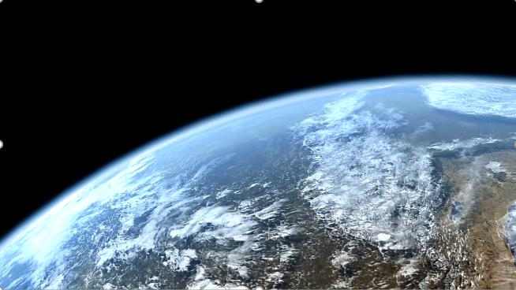
Tick it off, one-by-one
9. Andromeda
Bunga Sayang
Carol of the Drum
Sleigh Ride
A Christmas Festival
Frosty the Snowman
Jingle Bell Rock
Wizards in Winter
Raindrops Keep Falling on my Head
Andromeda
Nocturnal Fantasy
When You Wish Upon a Star
My Neighbour Totoro
Finished?
NO
* Click on the logo to return to main menu
Notes:
Higlighted red text to be included as hover text

Slide 22
Tick it off, one-by-one
Bunga Sayang
Carol of the Drum
Sleigh Ride
A Christmas Festival
Frosty the Snowman
Jingle Bell Rock
Wizards in Winter
Raindrops Keep Falling on my Head
Andromeda
Nocturnal Fantasy
When You Wish Upon a Star
My Neighbour Totoro
* Click on the logo to return to main menu
Notes:
Higlighted red text to be included as hover text

Slide 23
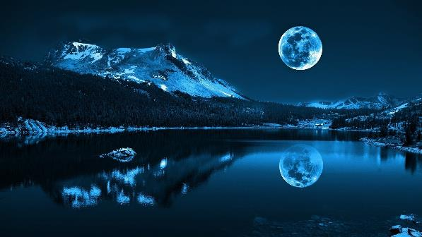
Tick it off, one-by-one
10. Nocturnal Fantasy
Bunga Sayang
Carol of the Drum
Sleigh Ride
A Christmas Festival
Frosty the Snowman
Jingle Bell Rock
Wizards in Winter
Raindrops Keep Falling on my Head
Andromeda
Nocturnal Fantasy
When You Wish Upon a Star
My Neighbour Totoro
Finished?
NO
* Click on the logo to return to main menu
Notes:
Higlighted red text to be included as hover text

Slide 24
Tick it off, one-by-one
Bunga Sayang
Carol of the Drum
Sleigh Ride
A Christmas Festival
Frosty the Snowman
Jingle Bell Rock
Wizards in Winter
Raindrops Keep Falling on my Head
Andromeda
Nocturnal Fantasy
When You Wish Upon a Star
My Neighbour Totoro
* Click on the logo to return to main menu
Notes:
Higlighted red text to be included as hover text

Slide 25

Tick it off, one-by-one
Bunga Sayang
Carol of the Drum
Sleigh Ride
A Christmas Festival
Frosty the Snowman
Jingle Bell Rock
Wizards in Winter
Raindrops Keep Falling on my Head
Andromeda
Nocturnal Fantasy
When You Wish Upon a Star
My Neighbour Totoro
Finished?
NO
* Click on the logo to return to main menu
Notes:
Higlighted red text to be included as hover text

Slide 26
Tick it off, one-by-one
Bunga Sayang
Carol of the Drum
Sleigh Ride
A Christmas Festival
Frosty the Snowman
Jingle Bell Rock
Wizards in Winter
Raindrops Keep Falling on my Head
Andromeda
Nocturnal Fantasy
When You Wish Upon a Star
My Neighbour Totoro
* Click on the logo to return to main menu
Notes:
Higlighted red text to be included as hover text

Slide 27

Tick it off, one-by-one
12. My Neighbour Totoro
Bunga Sayang
Carol of the Drum
Sleigh Ride
A Christmas Festival
Frosty the Snowman
Jingle Bell Rock
Wizards in Winter
Raindrops Keep Falling on my Head
Andromeda
Nocturnal Fantasy
When You Wish Upon a Star
My Neighbour Totoro
Finished?
NO
* Click on the logo to return to main menu
Notes:
Higlighted red text to be included as hover text

Slide 28
All done!
Have a safe journey home!
Bunga Sayang
Carol of the Drum
Sleigh Ride
A Christmas Festival
Frosty the Snowman
Jingle Bell Rock
Wizards in Winter
Raindrops Keep Falling on my Head
Andromeda
Nocturnal Fantasy
When You Wish Upon a Star
My Neighbour Totoro
* Click on the logo to return to main menu
Notes:
Higlighted red text to be included as hover text

Slide 29
Thank you!
Have a safe journey home!
See you in 2020!

